Slide 1
MEDIA KIT 2024
Data-driven
Direct mail
Delivered.
Reach your most qualified prospects at home, in their mailbox anywhere in Canada by leveraging the power of data, analytics, and digital integrations.
DRMG.com info@drmg.com
1.866.993.0600

Slide 2
TABLE OF CONTENTS
MEDIA KIT 2024
Company Overview 4 - 7
Who we are
Distribution overview
Our clientele
Products we offer
The Power of Direct Mail 9 - 11
No place like home
Direct Mail remains a powerful tool
Why boost your marketing mix
Our Solution Strategy 13 - 15
Turnkey campaign solution
Tackling key marketing strategies
3 Steps to success
Product Deep Dive 17 - 21
Shared Mail Overview
Solo Direct Mail
Personalized Mail
Performance Analytics
Sample Ads 23
DIRECT RESPONSE MEDIA GROUP

Slide 3
COMPANY
OVERVIEW
MEDIA KIT 2024

Slide 4
WHO WE ARE
MEDIA KIT 2024
OUR PURPOSE
Helping Canadians Save, Businesses Grow,
and Neighbourhoods Thrive; delivering more value to consumers, in their homes, and encouraging Canadians to shop local.
OUR BRAND PROMISE
On Time.
On Message.
On Target.
On Results.
OUR CORE VALUES
We treat people right.
We are in this to win.
We practice ferocious customer service.
We contribute to our communities.
The team is the heart of everything.
We know how to have a good time.
DRMG is Canada’s leading
Direct Mail Company.
We have been helping businesses of all sizes, from local to national boost sales and brand recognition through Targeted Direct Mail Campaigns for more than 20 years.
We are Canadian owned & Canada’s leading Direct Mail company delivering a wide range of neighbourhood mail, including our widely recognized Money Saver brand, regarded as Canada's most dependable publication for everyday savings and coupons.
We are a Canada Post Expert Partner, and their largest shared mail customer.
DIRECT RESPONSE MEDIA GROUP

Slide 5
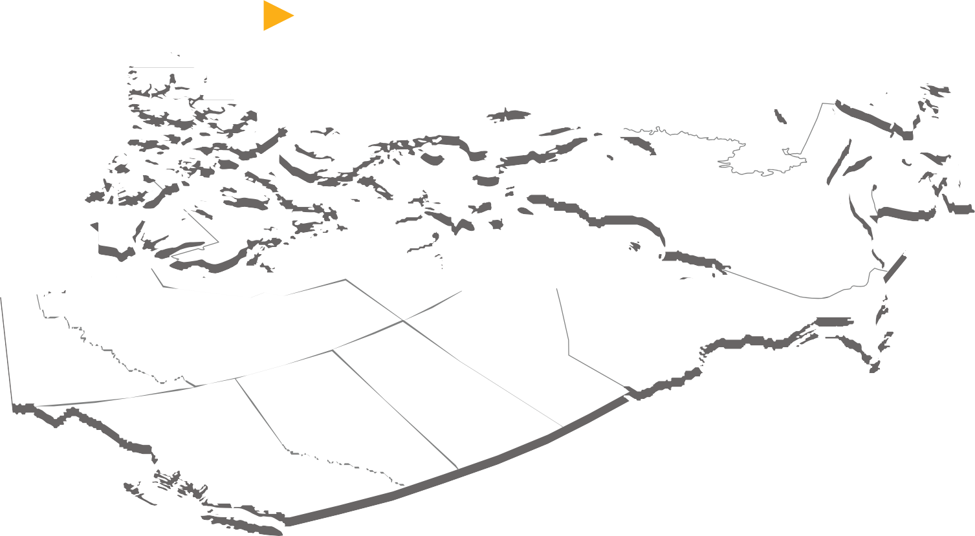
REACH ANYONE & EVERYONE
MEDIA KIT 2024
NATIONWIDE COVERAGE
DISTRIBUTION IS AUDITED & DELIVERY IS GUARANTEED BY CANADA POST
14.4M
Addresses you
can reach
3.4M
Condos & apartments
2M
Rural
addresses
779K
Businesses
DIRECT RESPONSE MEDIA GROUP

Slide 6
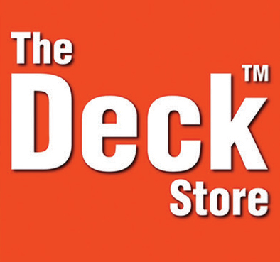
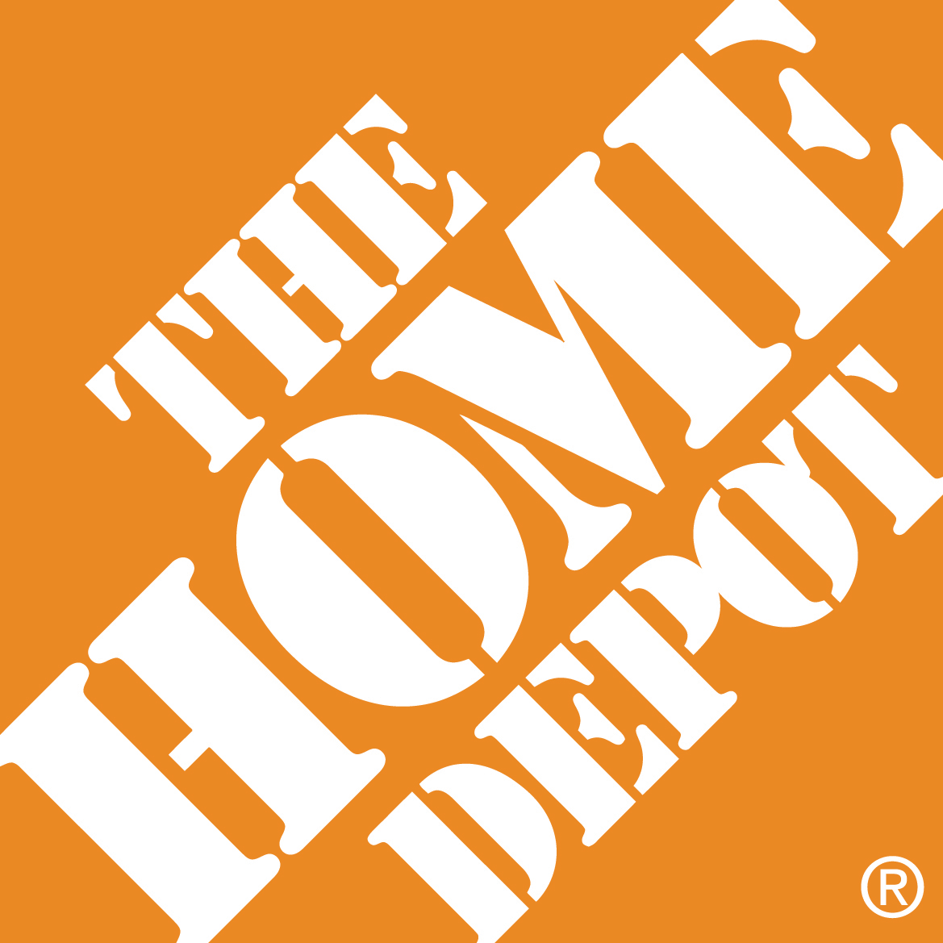
CUSTOMIZABLE SOLUTIONS
MEDIA KIT 2024
No matter what size or industry your business falls under, we are able to tailor a program that meets your marketing needs & budget.
DIRECT RESPONSE MEDIA GROUP

Slide 7
PRODUCTS WE OFFER
MEDIA KIT 2024
Targeted Direct Mail Products
Analytics & Insight
Broadly
Target
Defined
Targeting
Target by
Individual
Measure & Track Results
SHARED MAIL
Broadly reach homes in select neighbourhoods; targeting a preferred geographic profile through monthly scheduled publications featuring local, regional and national advertisers.
SOLO DIRECT MAIL
Choose your own mailing schedule with a standalone advertisement. Going solo provides micro-targeting capabilities, such as preferred geographic, demographic & psychographic profiles.
PERSONALIZED MAIL
Speak to a single person, household or business. Delivered in an envelope or addressed on the flyer itself.
DRMG INSIGHTTM
Proprietary analytic software provides the ability to track live customer engagement generated by Direct Mail campaigns.
> 14 publications in 7 provinces
> Reaching over 6 Million homes
> Across 234 zones (ave 26,963 homes/zone)
> Each zone covering multiple postal codes
> Reach 14.4 Million addresses
> 3.4 Million condos & apartments
> 779 Thousand businesses
> 2 Million rural addresses
> Target existing customers
> Maximize customer loyalty initiatives
> Captures leads by QR scans & number of calls
> Tracks location, date & time
> Records calls
DIRECT RESPONSE MEDIA GROUP

Slide 8
LEVERAGE THE POWER OF
DIRECT MAIL
MEDIA KIT 2024

Slide 9
NO PLACE LIKE HOME
MEDIA KIT 2024
You only have to look at your email inbox to understand the Power of Direct Mail
EXPOSURE CASE STUDY
200
40K
6
Emails
per day
Digital Ads per day
The home continues to be the center of our lives where important decisions are made. That makes direct mail the ideal channel to target customers. DRMG gives you the data, insights and expertise to make it happen.
And only
Direct Mail Pieces received per day
Customers are influenced by Direct Mail
advertising more than any other medium.
DIRECT RESPONSE MEDIA GROUP
Source: Canada Post, Kantar, SMM Stats update 2019

Slide 10
DIRECT MAIL REMAINS A POWERFUL TOOL
MEDIA KIT 2024
51%
Purchase
in-store or online
after receiving a Direct Mail Piece
71%
Share
Direct Mail
88%
Visit a store
or go online
92%
Read
Direct Mail
DIRECT RESPONSE MEDIA GROUP

Slide 11
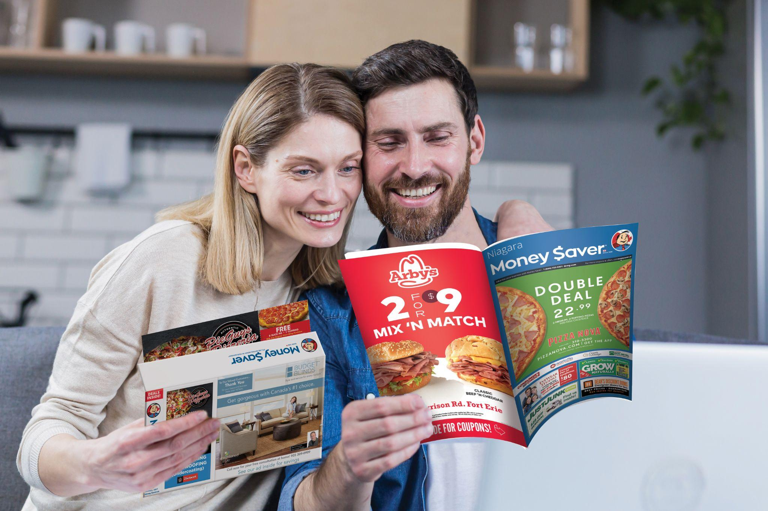
BOOST YOUR MARKETING MIX
MEDIA KIT 2024
Digital campaigns
including Direct Mail are
27%
more
likely
to deliver top-ranking sales performance, and
40%
more
likely
to deliver top-ranking acquisition levels, versus campaigns without mail.
DIRECT RESPONSE MEDIA GROUP

Slide 12
OUR SOLUTION STRATEGY
MEDIA KIT 2024

Slide 13
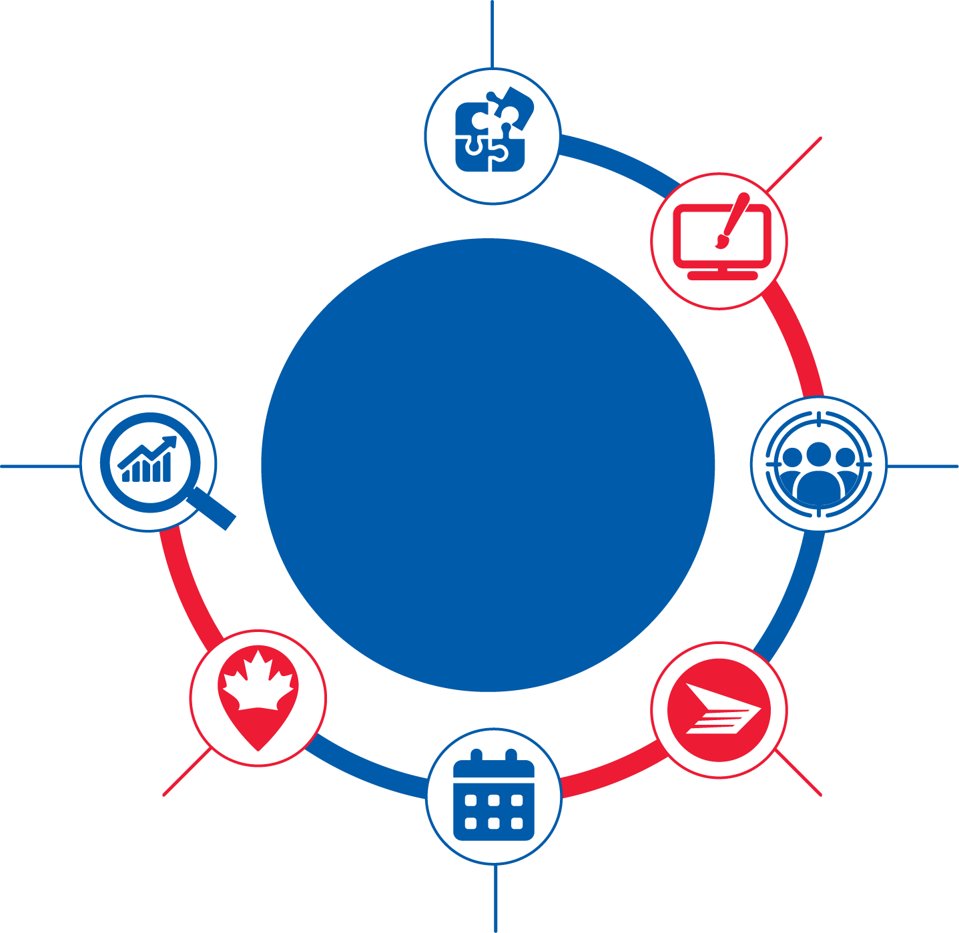
TURNKEY CAMPAIGN SOLUTION
MEDIA KIT 2024
We can help you with every aspect of your campaign objectives.
CAMPAIGN STRATEGY
Strategize with the client’s budget, target audience and objectives in mind.
AD DESIGN
In-house graphics department offering the best lead-generating offers & headlines by industry.
AN
ALL-IN-ONE
CAMPAIGN
SOLUTION
ANALYTICS & INSIGHT
Capture customer engagement generated by Direct Mail campaigns, providing insight on optimizing results, and an improved ROI.
TARGETED DIRECT MAIL
Shared, Solo & Personalized Direct Mail options, targeting ideal prospects geographically, demographically and psychographically using Canada Post advanced data & research.
NATIONWIDE COVERAGE
Wherever in Canada your target audience is, we are sure to reach them.
MAIL DISTRIBUTION
Mail prepped in-house; distributed, audited and delivery guaranteed by Canada Post.
FREQUENT IMPRESSIONS
Unlimited distribution options & multiple scheduled shared mail publications ensure you are noticed.
DIRECT RESPONSE MEDIA GROUP

Slide 14
WE TACKLE MARKETING CHALLENGES
MEDIA KIT 2024
Generating Leads & Acquiring Customers
Retaining
Customers
Budget & Resources
Measuring ROI
We provide advertisers with hyper-local targeting capabilities that generate quality leads; resulting in higher conversion rates and a higher return on investment.
We offer advertisers the ability to stay top of mind with consistent mailing schedules & new offerings, along with personalized mail options to stay connected with existing customers and build customer loyalty.
Consider us your “resources”. We design, print & deliver. And with a full range of Direct Mail options to choose from, there is a product for every budget.
With the ability to track incoming calls & QR Code scans generated by Direct Mail Campaign, it’s easy to determine the cost per lead & help allocate marketing budgets more effectively & improve the overall ROI of marketing campaigns.
DIRECT RESPONSE MEDIA GROUP

Slide 15
3 STEPS TO SUCCESS
MEDIA KIT 2024
DEFINE YOUR
TARGETING
CHOOSE A DIRECT MAIL CHANNEL
01
02
03
DEFINE YOUR TARGET AUDIENCE
Define your ideal target audience based on factors such as geographic location, demographic characteristics, buying patterns, and interests. These factors help create a more specific and targeted marketing strategy that resonates with potential customers who are most likely to be interested in what you have to offer.
CHOOSE A DIRECT MAIL CHANNEL
Select Direct Mail vehicles best suited to target your ideal prospects. It could be 1 or more monthly scheduled Shared Mail Publications or Solo Mail, micro-targeting capabilities, Personalized Mail, addressed to a specific customer base, or a combination. The key is to experiment & test your marketing efforts.
TRACK PERFORMANCE & LEARN
Link a telephone number and/or QR Code to our proprietary analytics software to track customer engagement generated by your Direct Mail Campaign. Improve your marketing strategies based on these insights and achieve a greater ROI.
DIRECT RESPONSE MEDIA GROUP

Slide 16
PRODUCT
DEEP DIVE
MEDIA KIT 2024

Slide 17
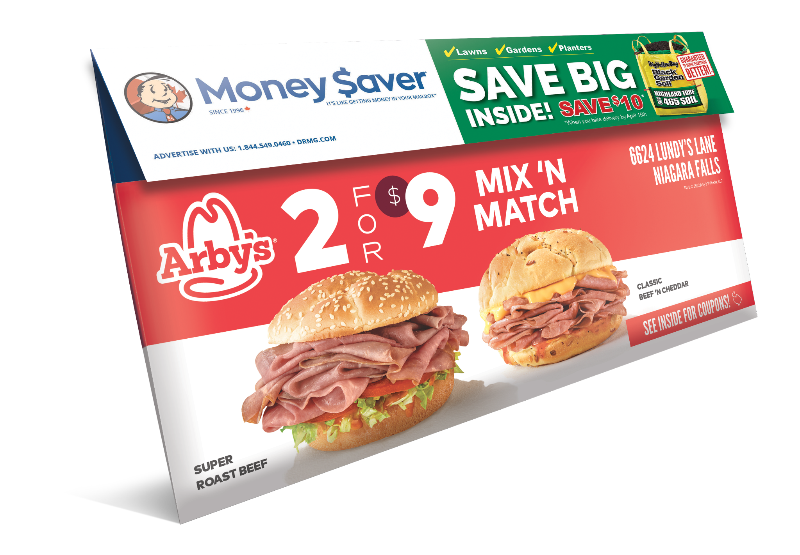
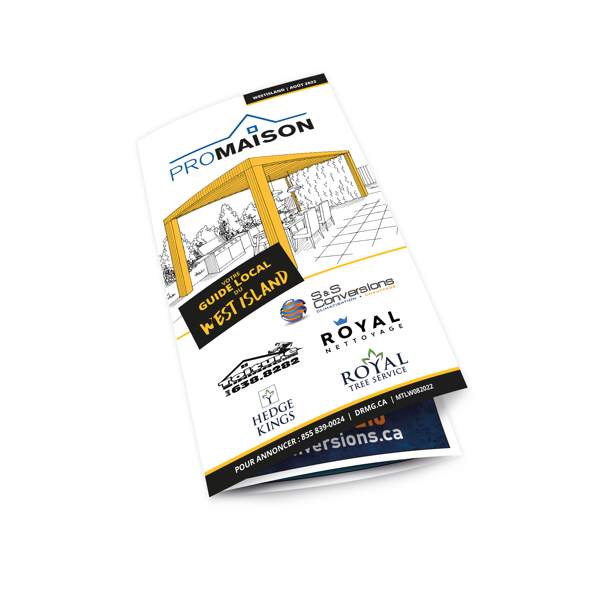
SHARED MAIL
MEDIA KIT 2024
Shared Mail Distribution
Share the cost of mail with local, regional & national advertisers
MONEY SAVER ENVELOPE
Niagara ON 87.5KHomes • 7 Zones
Vancouver BC 525K Homes • 43 Zones
Victoria BC 125K Homes • 10 Zones
Edmonton 150K Homes • 12 Zones
Maritimes 250K Homes • 20 Zones Montreal 900K Homes • 70 Zones
DRMG’s monthly scheduled Shared Mail Products broadly reach every home apartment and business in select neighbourhoods; targeting preferred geographic profiles. Shared Mail offers competitive pricing that allows advertisers to reach a broad audience at a fraction of the cost of mailing their flyer or postcard as a standalone.
MONEY SAVER
MAGAZINE
GTA ON
1,735.5K Homes
38 Zones
Winnipeg MB
120K Homes •
4 Zones
Kelowna BC
50K Homes
4 Zones
HOME SAVER
MAGAZINE
GTA ON
800K Homes
4 Zones
GREATER
TORONTO LIVING
GTA ON
650K Homes
3 Zones
AD SAVE
MAGAZINE
Western ON
406K Homes
8 Zones
Local advertisers: Shared Mail is an affordable option for local businesses looking to target specific neighborhoods or postal codes.
Regional advertisers: For advertisers targeting a broader geographic area, Shared Mail is effective and cost-effective.
National advertisers: Shared Mail is a viable option for national advertisers looking to reach a wide audience.
PROMAISON
SOLO PLUS
Montreal
100K Homes
2 Zones
PROCOMMERCE
SOLO PLUS
Montreal
100K Homes
1 Zone
DRMG
SOLO PLUS
Duncan, Sidney,
Sooke, Agassiz BC
22,500 Homes
3 Zones
DIRECT RESPONSE MEDIA GROUP

Slide 18
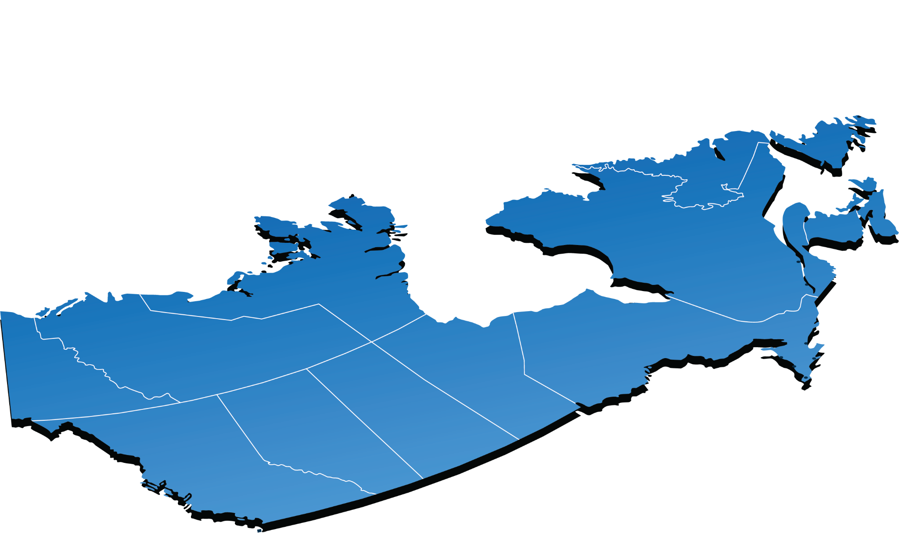
SHARED MAIL DISTRIBUTION
MEDIA KIT 2024
MONEY SAVER MAGAZINE KELOWNA
• Reaching 50K homes
• Across 4 Distribution Zones
• Published 12x per year
MONEY SAVER ENVELOPE VANCOUVER
• Reaching 525K homes
• Across 43 Distribution Zones
• Published 11x per year
MONEY SAVER ENVELOPE VICTORIA
• Reaching 125K homes
• Across 10 Distribution Zones
• Published 11x per year
DRMG SOLO PLUS DUNCAN, SIDNEY,
SOOKE, AGASSIZ
• Reaching 30K homes
• Across 4 Distribution Zones
• Published 8 per year
MONEY SAVER MAGAZINE GTA
• Reaching 1,885.5K homes
• Across 43 Distribution Zones
• Published 12x per year
MONEY SAVER ENVELOPE NIA
• Reaching 87.5K homes
• Across 7 Distribution Zones
• Published 6x per year
AD SAVE MAGAZINE WESTERN ON
• Reaching 458K homes
• Across 6 Distribution Zones
• Published 11x per year
HOME SAVER MAGAZINE GTA
• Reaching 800K homes
• Across 4 Distribution Zones
• Published 5x per year
GREATER TORONTO LIVING GTA
• Reaching 650K homes
• Across 3 Distribution Zones
• Published 7x per year
MONEY SAVER
ENVELOPE EDMONTON
• Reaching 137.5K homes
• Across 11 Distribution Zones
• Published 11x per year
1.2M
HOMES
MONEY SAVER ENVELOPE MARITIMES
• Reaching 250K homes
• Across 20 Distribution Zones
• Published 10x per year
3.7M
HOMES
120K
HOMES
137.5K
HOMES
MONEY SAVER ENVELOPE MONTREAL
• Reaching 900K homes
• Across 70 Distribution Zones
• Published 10x per year
PROMAISON SOLO PLUS MONTREAL
• Reaching 100K homes
• Across 2 Distribution Zones
• Published 4x per year
PROCOMMERCE SOLO PLUS MONTREAL
• Reaching 100K homes
• Across 1 Distribution Zone
• Published 4x per year
700K
HOMES
MONEY SAVER
MAGAZINE WINNIPEG
• Reaching 120K homes
• Across 4 Distribution Zones
• Published 8x per year
DIRECT RESPONSE MEDIA GROUP

Slide 19
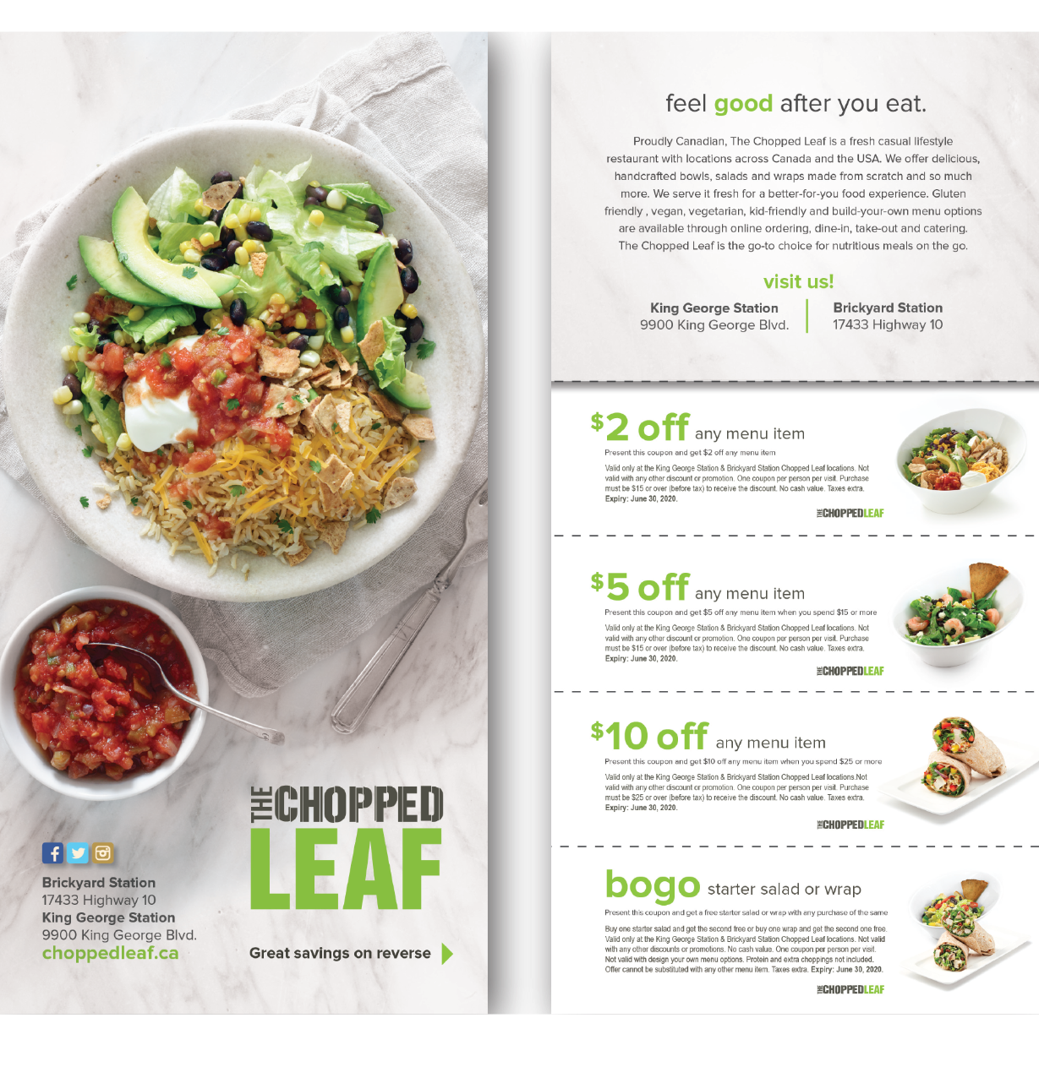
SOLO DIRECT MAIL
MEDIA KIT 2024
Choose a format
Mail when you want & where you want.
Make the most impact in mailboxes with a standalone advertisement and brand exclusivity. Solo Direct Mail provides the ability to target potential customers within a very specific geographic area, such as a neighborhood, city block, or even a single building. This approach allows businesses to reach people who are most likely to be interested in their products or services based on their location and other relevant demographic factors.
SOLO CARD
5.25 X 10.875
DOUBLE
SOLO CARD
10.5 X 10.875
FLYER
10.5 x 8.25
Reach more deliverable addresses. With our targeted data, select mailing zones to align with your campaign goals.
DELUXE POSTCARD
5.125 X 9
100% branded to your business: no shared ad space. Uninterrupted in the mailbox
Track separately from other media campaigns with call tracking, tracking URL and QR code.
MENU - 3 OR 4 PANEL
16 x 8.25
Competitive direct mail rate for maximum reach and ROI.
14.4 million addresses to reach 3.4 Million Condos & Apartments 2 Million Rural Addresses
XL MENU 3 OR 4 PANEL
16.75 x 10.75
DIRECT RESPONSE MEDIA GROUP

Slide 20
PERSONALIZED MAIL
MEDIA KIT 2024
Engage with active & past customers
Personalized Mail™ is a one-to-one communication, allowing for a tailored message directly to customers or prospects. The address may or may not have a contact name. The list of addresses can be your list of customers or can be bought/rented.
Personalized Mail™ can help acquire new customers, deepen connections with existing ones and build customer loyalty. For example, not-for-profits often rent lists to obtain new donors, and financial institutions use Personalized Mail to communicate regularly with customers as well as send them special promotions.
Here are some ideas on how businesses can use personalized mail to engage with customers:
Customized offers: Tailoring offers to customers' specific interests and purchasing behaviors.For example, a clothing retailer could send a discount offer on items that the customer has previously shown an interest in or purchased.
Special Events & Promotions Invite customers to special events or promotions, such as product launches, store openings, or exclusive sales. Personalized mail can create a sense of exclusivity and make customers feel valued.
Thank you notes & loyalty rewards: Thank customers for their loyalty and encourage continued engagement. Businesses can send personalized thank you notes and loyalty rewards, such as discounts or exclusive access to new products.
DIRECT RESPONSE MEDIA GROUP

Slide 21
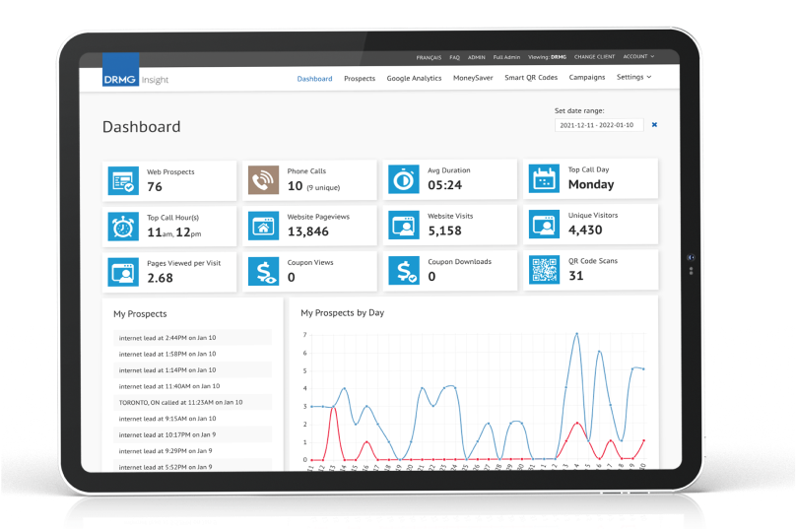
ANALYTICS & INSIGHT
MEDIA KIT 2024
Measure your advertising return by tracking calls and QR code scans in our DRMG Insight Analytics Dashboard.
DRMG Insight is our proprietary analytics software that provides you the ability to track customer engagement generated by your Direct Mail Campaign. Gain valuable insights into the prospects you attract, their behaviors and preferences, and refine your marketing strategies to improve the customer experience, drive better results and achieve greater ROI from your marketing efforts.
CAPTURE LEADS Track all incoming calls and QR Code Scans & listen to calls
OBSERVE View & monitor customer engagement in real time
SCORE EACH LEAD Score qualified & unqualified leads
SCORE YOUR TEAM Evaluate the response to lead calls
EVALUATE ROI Calculate your cost-to-lead ratio
CAPTURE LEADS Analyze results to optimize your marketing strategy
DIRECT RESPONSE MEDIA GROUP

Slide 22
SAMPLE
ADS
MEDIA KIT 2024

Slide 23
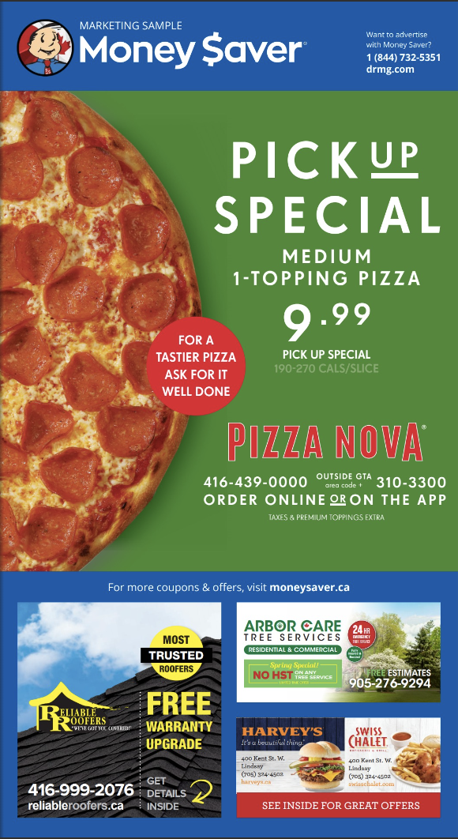
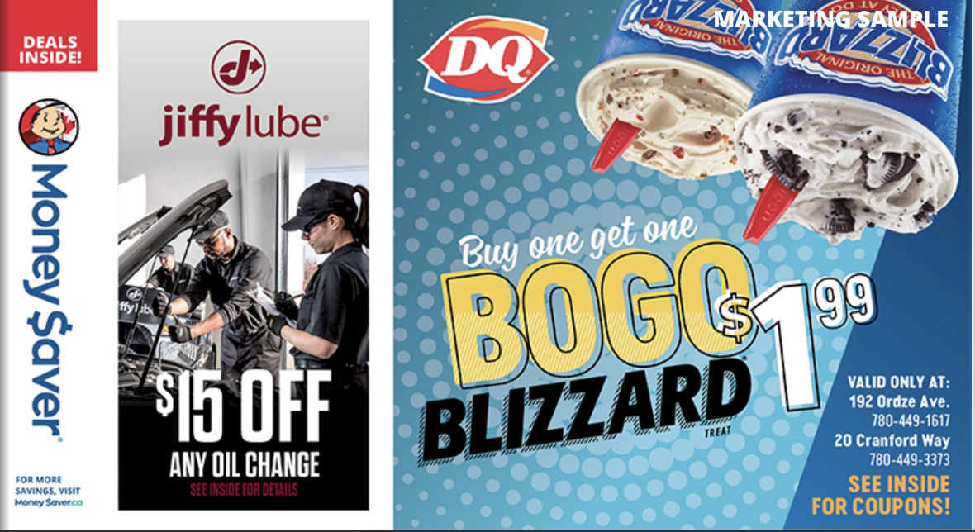
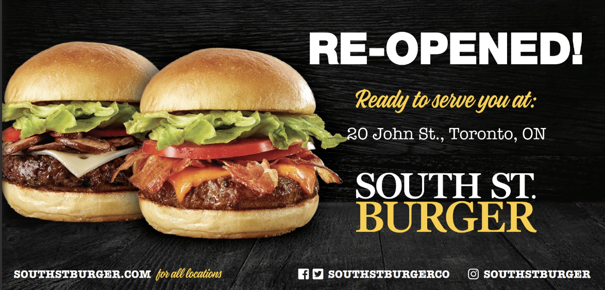
SAMPLE ADS
MEDIA KIT 2024
MONEY SAVER ONTARIO
Link to Flipbook
HOME SAVER
Link to Flipbook
GREATER TORONTO LIVING
Link to Flipbook
AD SAVE
Link to Flipbook
MONEY SAVER ENVELOPE
Link to Flipbook
MONEY SAVER ENVELOPE MTL
Link to Flipbook
SOLO MAILERS
Link to Solo Samples
DIRECT RESPONSE MEDIA GROUP

Slide 24
MEDIA KIT 2024
To find out more on how to integrate direct mail into your marketing mix, contact a DRMG marketing expert.
Let’s get your campaign started.
DIRECT RESPONSE MEDIA GROUP
240 Wyecroft Road, Oakville, ON L6K 3Y6
DRMG.com info@drmg.com
1.866.993.0600

